Slide 1
Moral Theme
This Photo by Unknown Author is licensed under CC BY-SA-NC

Slide 2
What is moral theme?
Morality

Slide 3
A moral is a type of message in a story that teaches a lesson about right and wrong, or how to make decisions and treat others. We see moral theme usually in fairy tales, folktales, and fables.

Slide 4
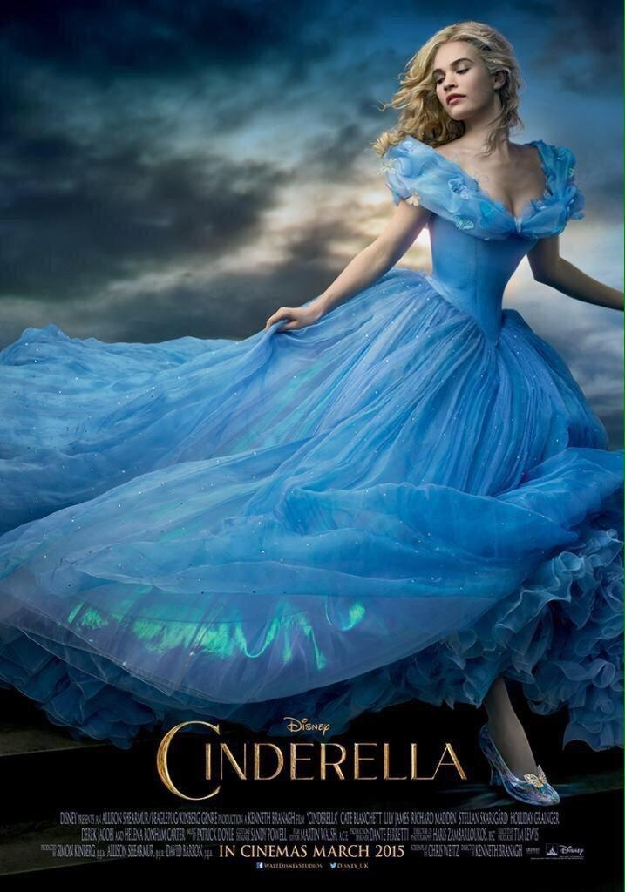
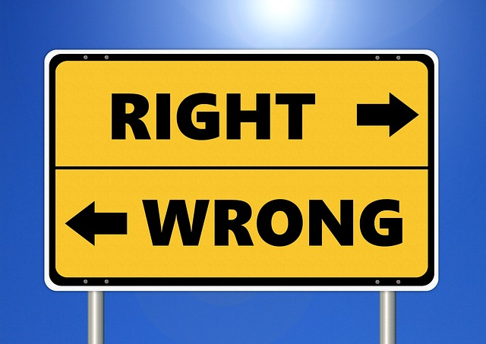
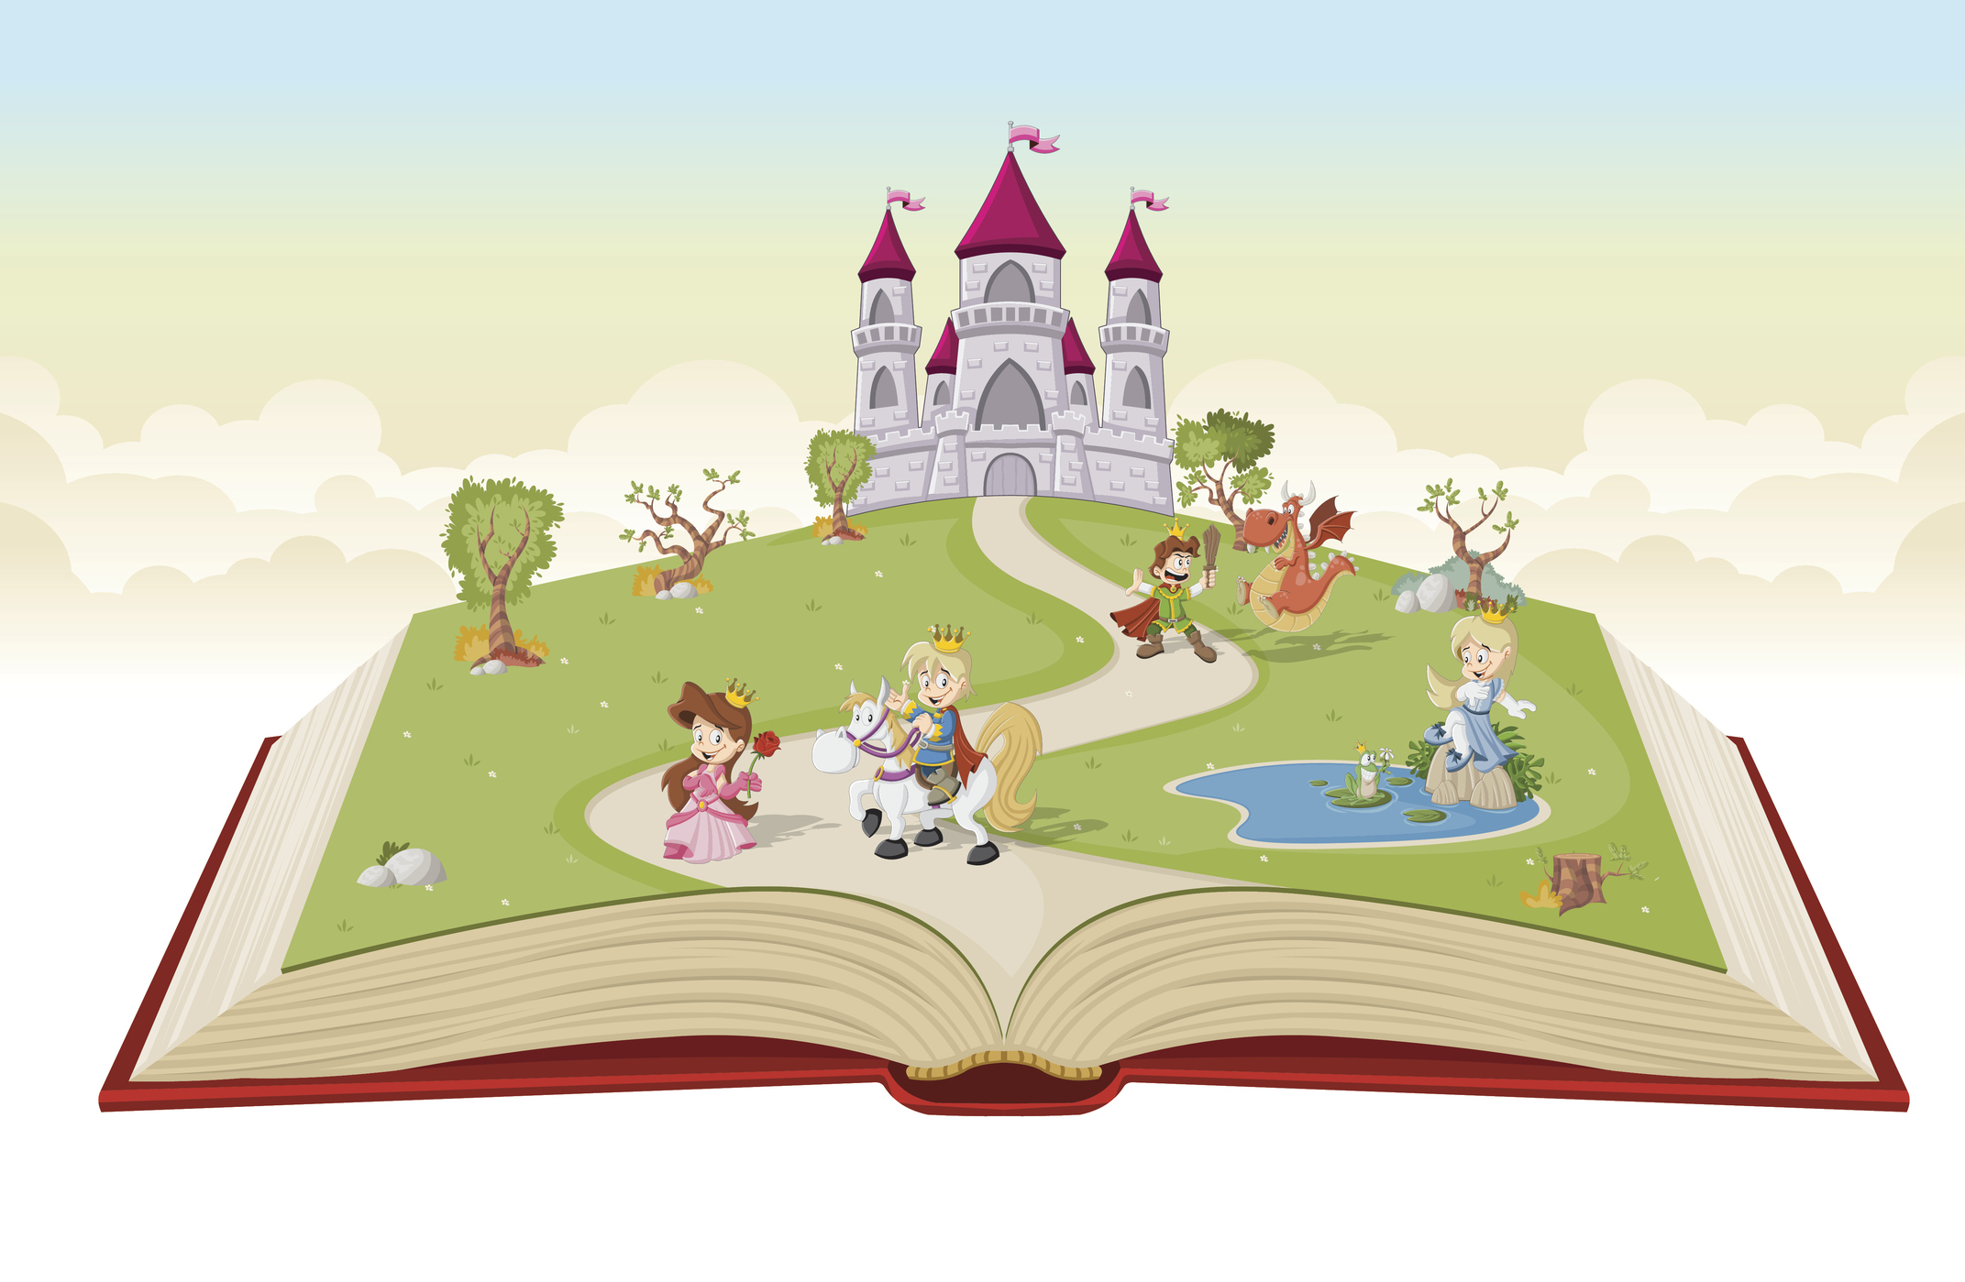
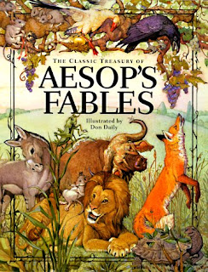
This Photo by Unknown Author is licensed under CC BY-NC-ND
This Photo by Unknown Author is licensed under CC BY-NC
This Photo by Unknown Author is licensed under CC BY-NC

Slide 5
The Tortoise and the Hare The Fox and the Crow The Ant and the Grasshopper The Little Red Riding Hood
Moral Theme stories

Slide 6
Moral Theme Stories
The Emperor's New Clothes
This Photo by Unknown Author is licensed under CC BY

Slide 7
What do you think is the moral or lesson of the story The Emperor’s New Clothes ?

Slide 8
The moral of the story is: It is best to trust oneself and be honest; Speak up for the truth and what is right. Without honesty, people often end up looking very foolish.

Slide 9
Moral Theme Stories
The Empty Pot
This Photo by Unknown Author is licensed under CC BY

Slide 10
What do you think is the moral or lesson of the story The Empty Pot?

Slide 11
The moral of the story "The Empty Pot" is that honesty and hard work are more valuable than deceit. Being truthful can lead to unexpected rewards.

Slide 12
How are two stories similar or different? Cut each sentence and glue each under correct category.
Similarities
Differences

Slide 13
Check your work. How are two stories similar or different?
Similarities
Both stories have emperors.
Both stories are folktales from a long time ago.
Both stories have children.
Both stories have a moral message, the importance of being honest.
In both stories there was an honest child who told the truth.
Differences
One story is from Chinese culture, the other is not.
One story involves growing plants from seeds , the other involves the emperor’s new clothes and a parade.
The emperor in the Empty Pot is much wiser than the emperor in The Emperor’s New Clothes.
The emperor in The Empty Pot found a successor for his kingdom, while the emperor in The Emperor’s New Clothes was shamed for his dishonesty.

Slide 14
Exit ticket

Slide 15
Draw a check mark under the correct letter T or F to indicate if each sentence is True or False | T | F
The moral of the story The Emperor and his New Clothes is without honesty; people often end up looking very foolish.
A moral is a type of message in a story that teaches a lesson about right and wrong.
Both emperors were wise.
Both stories originated from China.
Both stories had emperors.
The moral of the story The Empty Pot is honesty and hard work are more valuable than deceit.
Moral theme is usually found in fairy tales, folk tales, and fables.
The Boy Who Cried “Wolf” is a fable with moral theme.
Both tales, The Emperor’s New Clothes and The Empty Pot have similar moral themes about honesty.

Slide 16
Thank you!

Slide 17
Additional slides are below for extra work if needed.

Slide 18
Moral theme words
Good
positive
Kind
Love
Sharing
Caring
Optimistic
Selfless
Empathetic
Bad
Evil
Negative
Hatred
Pessimistic
Selfish
Unkind

Slide 19
Synonyms
Synonyms are similar words.
Good = nice

Slide 20
Antonyms are opposite words good Evil

Slide 21
Connect each word to its antonym (opposite word)
Good
positive
Kind
Love
Sharing
Caring
Optimistic
Selfless
Empathetic
Bad
Evil
Negative
Hate
Pessimistic
Selfish
Unkind
Uncaring
Self-centered

